Slide 1
PFAS Source Identification and Prediction Through Fingerprinting
Sarabeth George

Slide 2
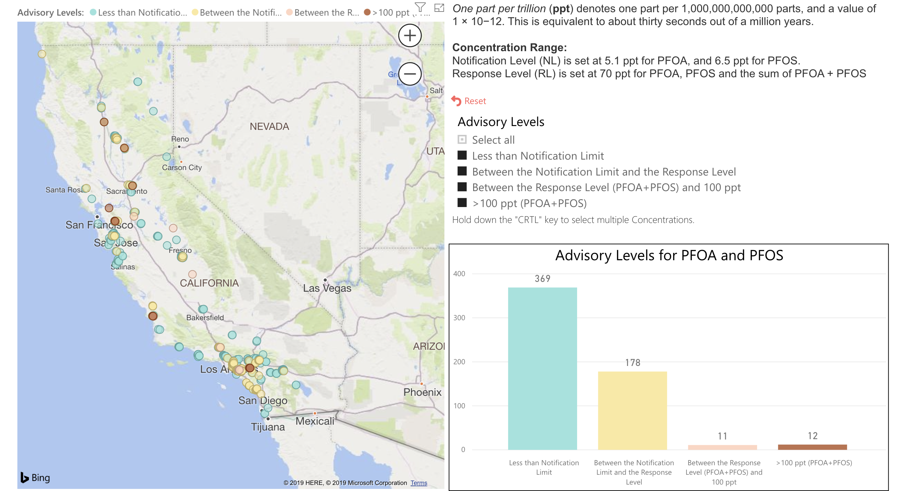
Background
[PROBLEM ADDRESSED]
[NOTE: KEEP BACKGROUND INFO LIMITED. ONLY INTRODUCE WHAT IS CRITICAL TO UNDERSTAND PROJECT, I.E. DATASETS USED, THEORETICAL BASIS, ETC.]
Notes:
It is everywhere—there is no part of the state (or world) that is unaffected.
But there is good news: there are locations where PFAS are non-detect and/or below regulatory thresholds.
Goal:
Protect these ‘clean’ sources
Stop contamination
Clean up contaminated areas

Slide 3

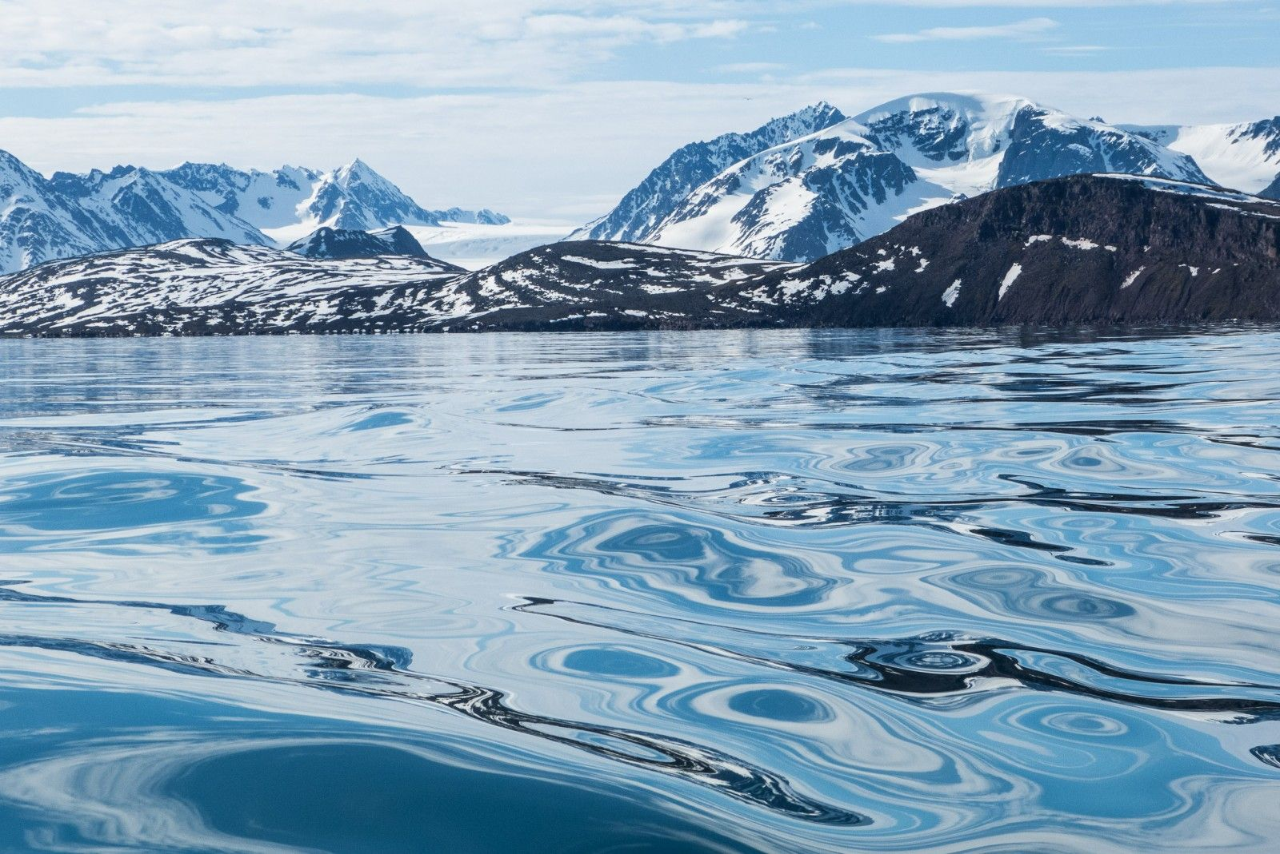

(Paleo)climatology
Notes:
alkenone molecule
background is in paleoclimatology, where we use these chromatographs to reconstruct past climate conditions
‘noise’ is data! noise gives us a lot of information in this data that would be otherwise missed
works for the past 120 million years

Slide 4
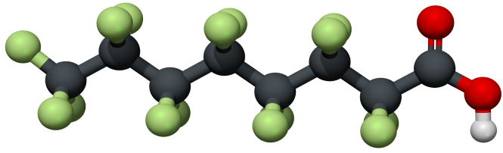
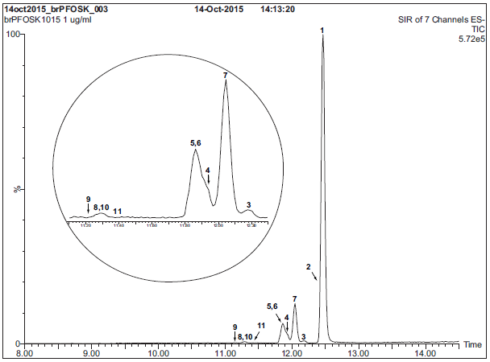
F
F
H
F
C
C
C
C
C
C
C
C
F
F
F
H
Taryn McKnight /Eurofins TestAmerica
Notes:
polyfluorinated chem structure
Noise is a problem for quantitation, but noise can also can be signal.
Can we use existing, noisy data to gain insights into the PFAS problem?
Overview of Existing PFAS Chemistry and Laboratory Analysis Methods Taryn McKnight

Slide 5
1. Dataset
Downloaded all PFAS sampling results for the state of California and associated monitoring data for other chemicals (GAMA, DDW, SDWIS, UCMR3)
Cleaned and normalized data to uniform scale
Integrated data into single file for downstream analysis

Slide 6
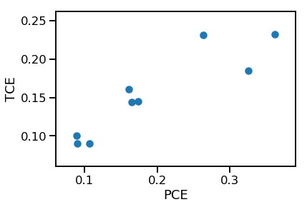
2. Correlation
correlation = 0.89
December 5, 2019
Notes:
This is the expected correlation between the concentration PCE and TCE that we see in our data is due to the breakdown of these chemicals in the environment. PCE is a precursor to TCE in the breakdown process. We expect similar relationships with PFAS.
THESE CORRELATIONS are useful for interpolating missing data. (Eg, only measured PCE, but want to model how much TCE)
On a local scale, PFAS concentrations vary and our limited data are already enough to start tentatively investigating source areas.
These variations are controlled by:
Natural processes (eg geology, precipitation, evaporation)
Anthropogenic effects (eg water recycling, wastewater release, other contamination)
Chemical interactions between water + environment and chems within the water mixture (eg biotic or abiotic degradation to daughter products)

Slide 7
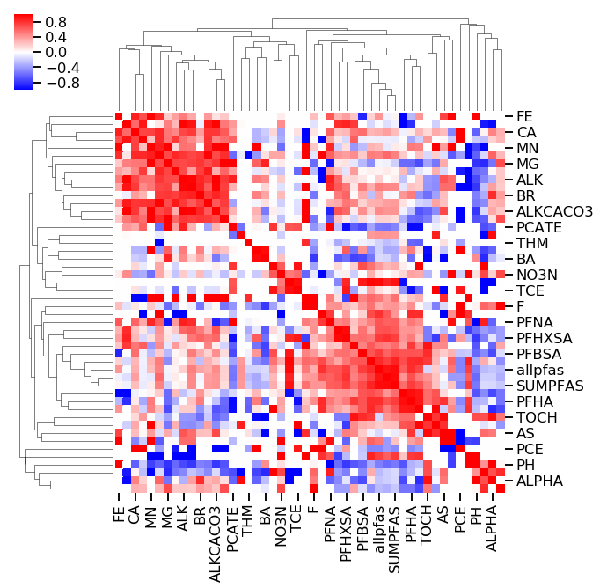
2. Correlation
correlation = 0.89
December 5, 2019
Notes:
If we make a figure colored by the pos/neg value of all chemical pairs in the dataset, we get a clustermap.

Slide 8
Notes:
Emphasize everything is 100% correlated with itself.
These variations are controlled by:
Natural processes (eg geology, precipitation, evaporation)
Anthropogenic effects (eg water recycling, wastewater release, other contamination)
Chemical interactions between water + environment and chems within the water mixture (eg biotic or abiotic degradation to daughter products)

Slide 9

3. Clustering &
Fingerprinting
December 5, 2019
Notes:
PCA and UMAP

Slide 10
3. Clustering &
Fingerprinting
Fingerprint 1
Fingerprint 2
Fingerprint 3
Fingerprint 4
Fingerprint 5
December 5, 2019
Notes:
On a local scale, PFAS concentrations vary and our limited data are already enough to start tentatively investigating source areas.
These variations are controlled by:
Natural processes (eg geology, precipitation, evaporation)
Anthropogenic effects (eg water recycling, wastewater release, other contamination)
Chemical interactions between water + environment and chems within the water mixture (eg biotic or abiotic degradation to daughter products)

Slide 11
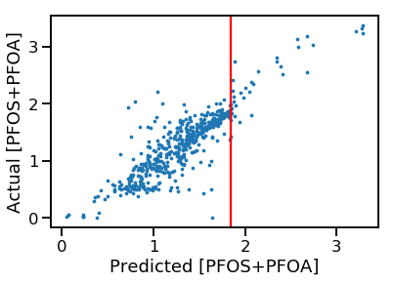
4. PFAS Prediction from non-PFAS monitoring data
EPA HAL = 70 ppt
December 5, 2019
Notes:
On a local scale, PFAS concentrations vary and our limited data are already enough to start predicting exceedances of the US EPA HAL.
HAL=health advisory level

Slide 12
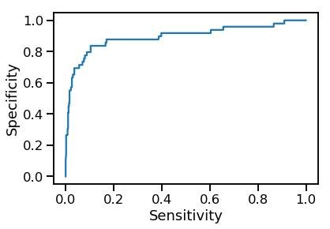
4. PFAS Prediction from non-PFAS monitoring data
(true pos rate)
EPA HAL = 70 ppt
(false pos rate)
December 5, 2019
Notes:
Model predicts continuously, but then we
Thresholded using EPA HAL: rate of false vs true positives for exceedances

Slide 13
4. PFAS Prediction from non-PFAS monitoring data
(true pos rate)
Good model ☺
EPA HAL = 70 ppt
(false pos rate)
December 5, 2019
Notes:
Model predicts continuously, but then we
Thresholded using EPA HAL: rate of false vs true positives for exceedances

Slide 14
Cross Section
Map View
W3
W1
W2
A’
A’
B
A
A
Water Bearing Zone 2
Water Bearing Zone 1
B’
Fault
5 miles
W6
W4
W5
B’
B
Water Bearing Zone 3
Notes:
Local level= uses other chemdata (pH, alk, metals, anthro chemicals) to ID connected water bearing zones

Slide 15
5. Source Identification
Fingerprint 1 = Source A
Fingerprint 2 = Source B
Fingerprint 3 = Source C
Fingerprint 4 = Source D
Fingerprint 5 = Source E
December 5, 2019
Notes:
Local level= uses other chemdata cluster similar-looking wells which may be useful for source area identification
We developed the dataset to do this during the datathon yesterday and today and will continue developing this tool.

Slide 16
Summary
Existing PFAS and other chemical monitoring data contain useful information for identifying areas of concern
This tool could be used to ‘fingerprint’ PFAS profiles, identify source areas, and expedite the cleanup process
This tool could also be used as guidance for future monitoring programs where groundwater is used as a source of drinking water
December 5, 2019

Slide 17
Thank you!
PFAS Source Identification Through Fingerprinting
Thank you ~wonderful~ Datathon collaborators!*
Priya Shivaani Chauhan, Jennifer Chen, Sara Huber, Erica Kalve, Brittany Saleeby, Susie Smith
*Collaborators listed in alphabetical order.

